Slide 1
Project Introduction - bank system
Leader: Josh
Member:
Josh,Vivi, Steven, Charlie, Jone, Eden

Slide 2
What is Project ?
A project is an effort by people to use new methods to organize human, material and financial resources to complete an independent, one-time task within a given cost and time constraint specification in order to achieve the goals defined by the quantity and quality indicators

Slide 3
Why need bank system ?
Easy to charge the money in the internet
7x24 hour provide service
replace traditional bank complex process

Slide 4
bank system advantage?
convenient
digitization
security

Slide 5
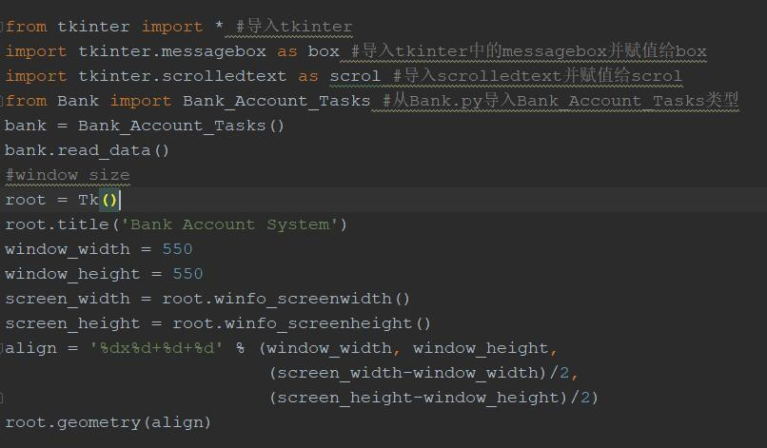
GUI part - window
This section import Tk Library
use to create Visual interface
window width set 550px
window height set 550px
winfo_screenwidth() and
winfo_screenhegiht() function will
get PC current screen width&height
align will receive format data
geometry function to set window

Slide 6
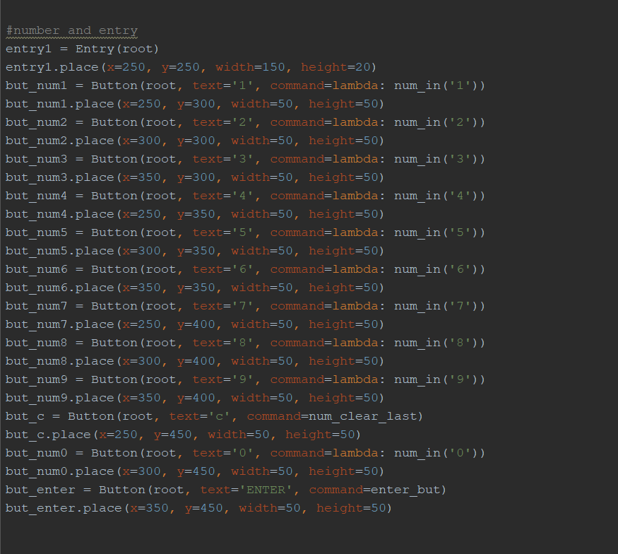
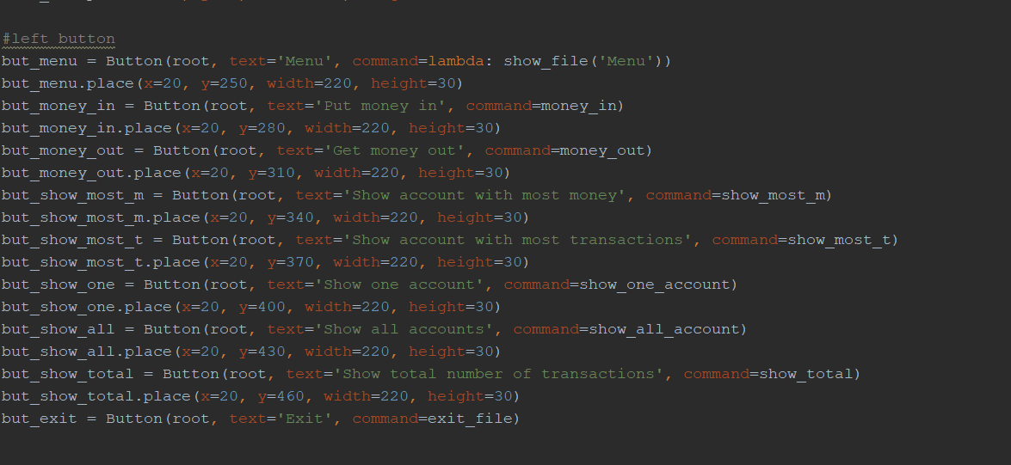
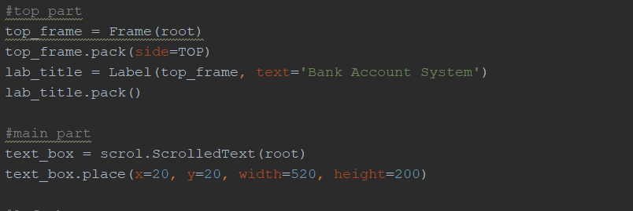
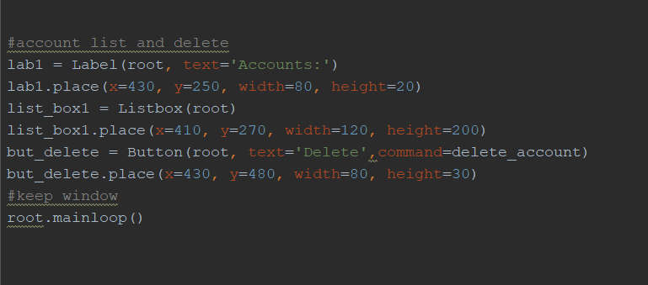
Interface layout

Slide 7
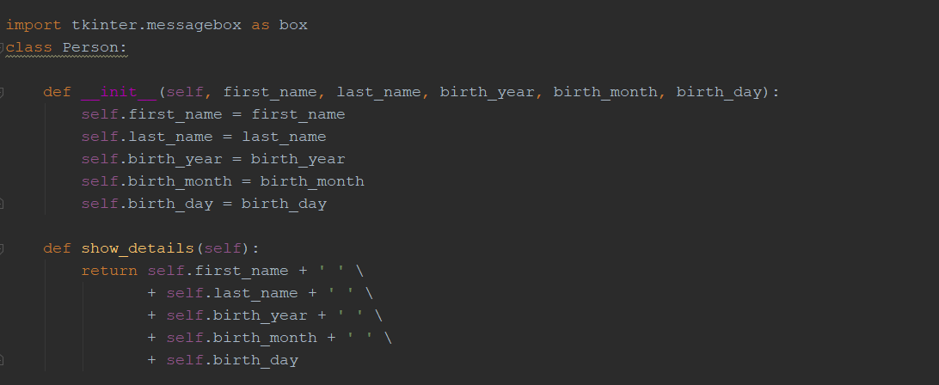
backstage supporter - class

Slide 8
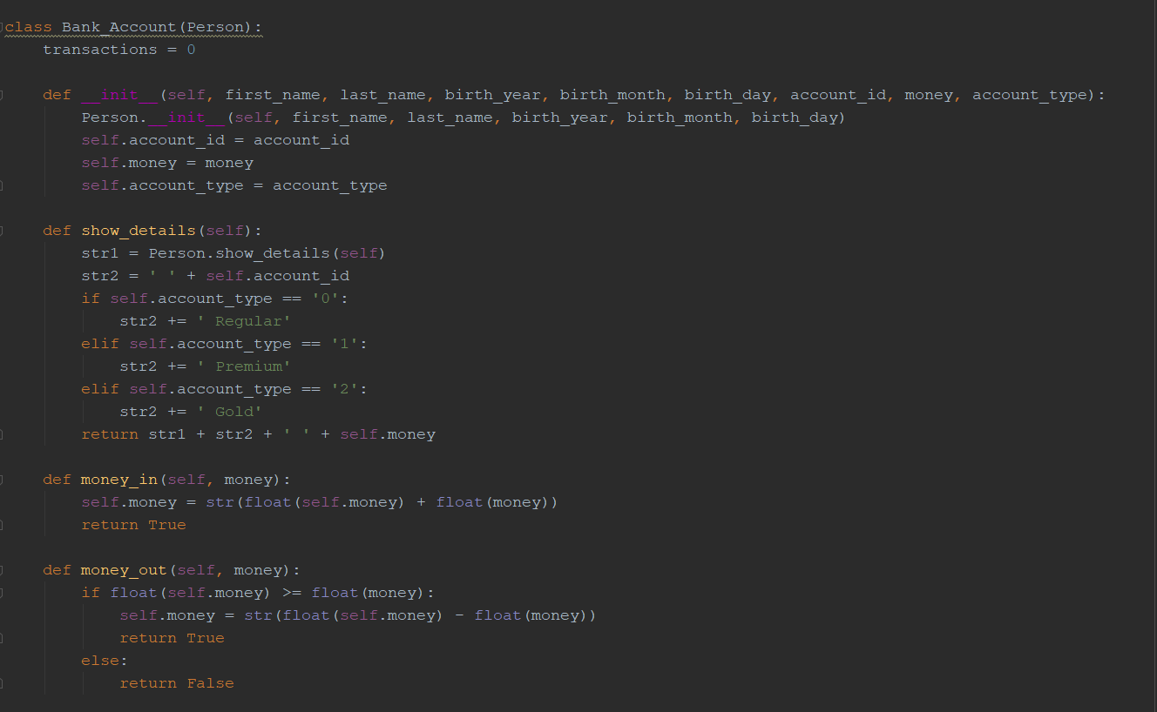
Bank_Account

Slide 9
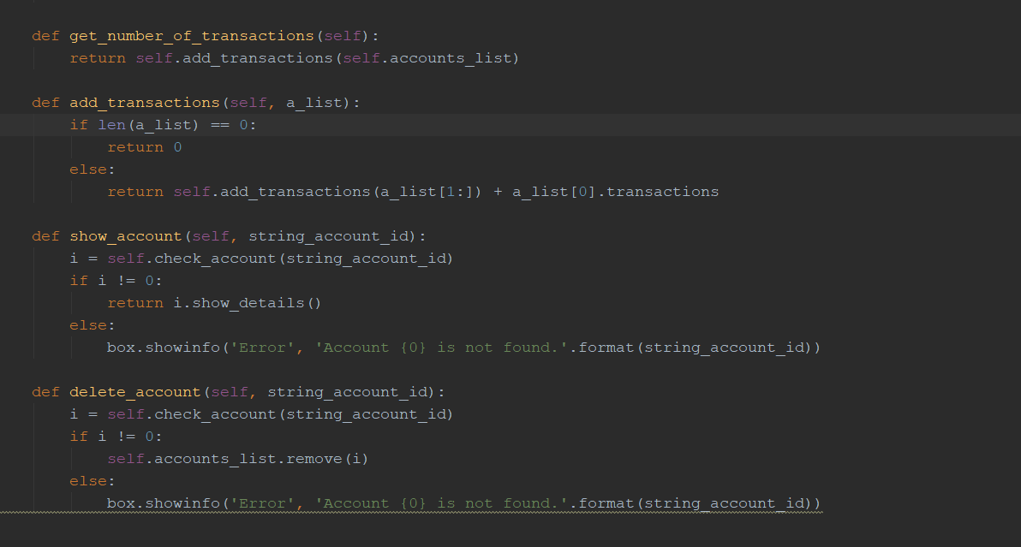
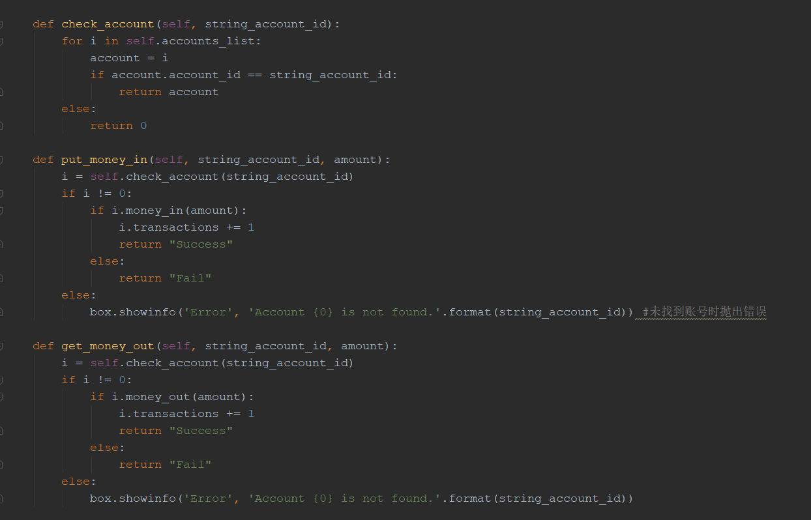
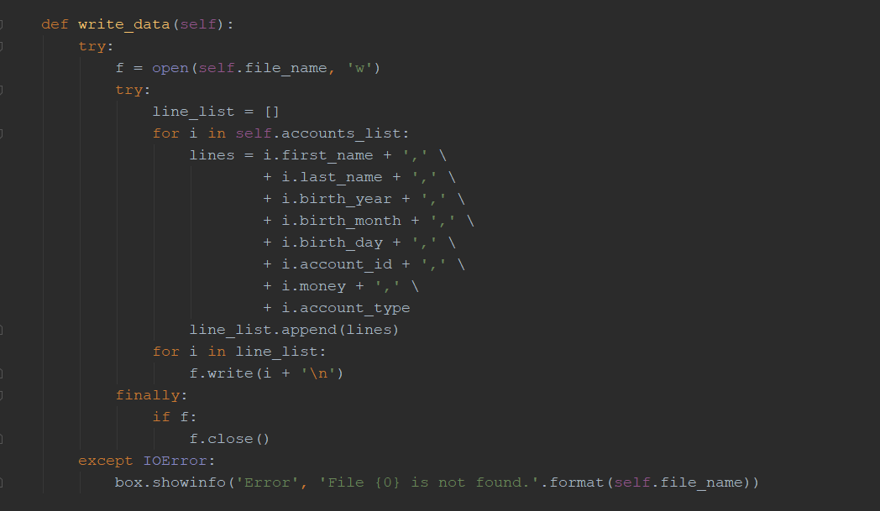
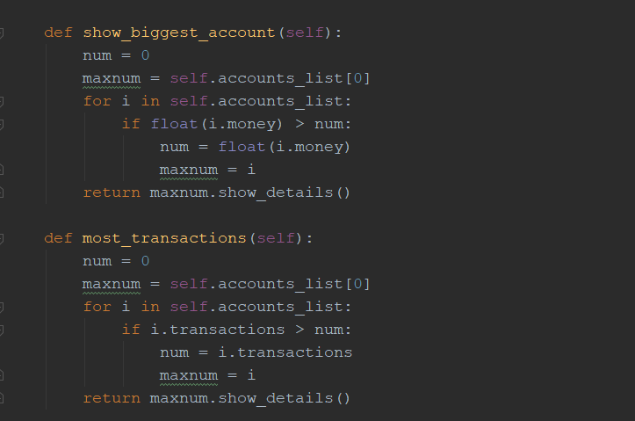
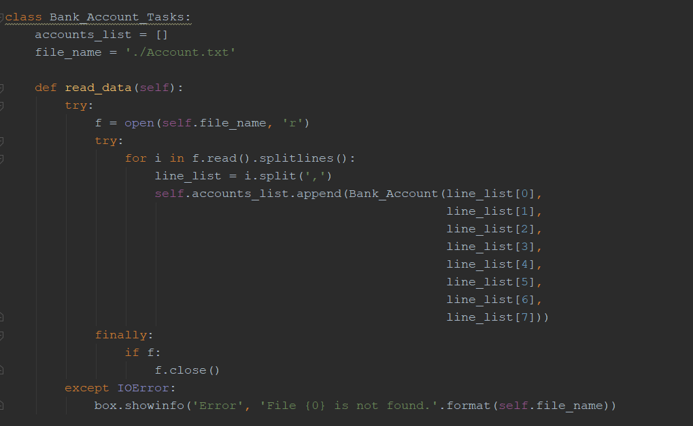
Bank_Account_Tasks

Slide 10
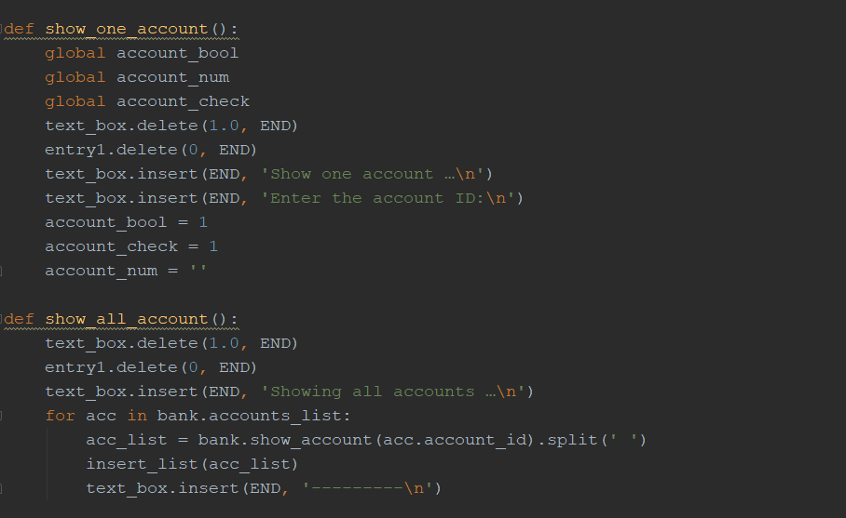
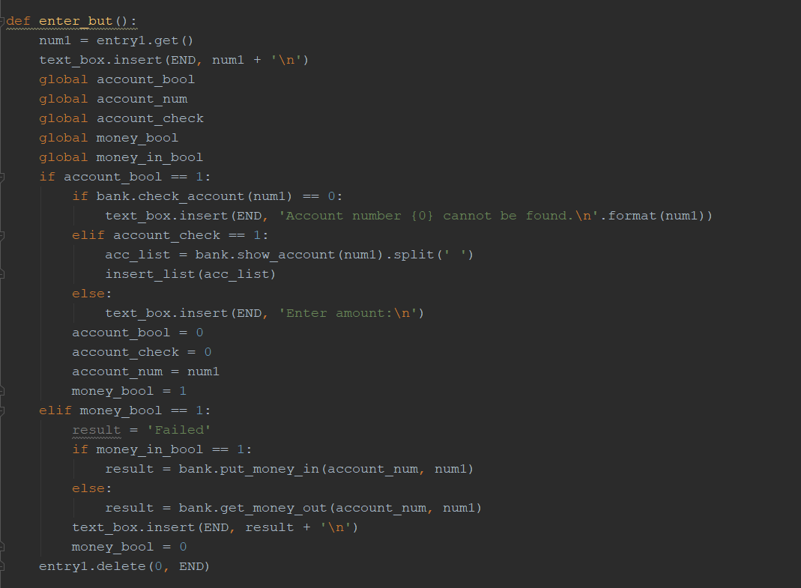
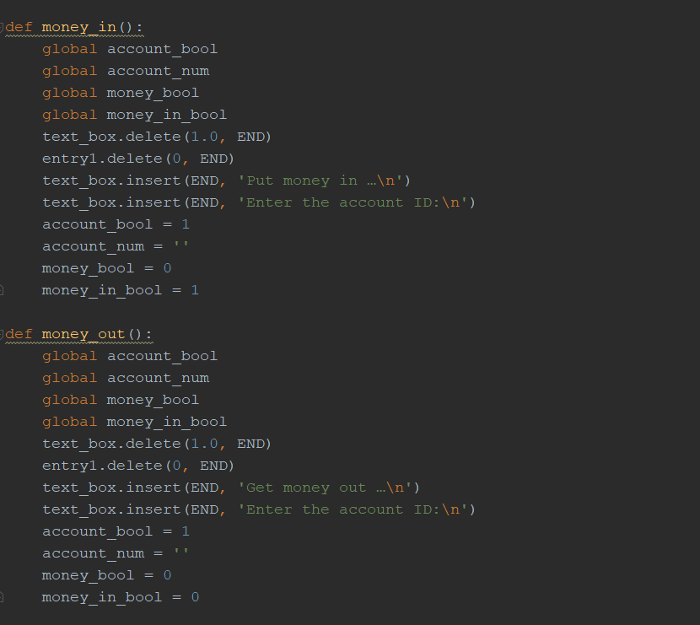
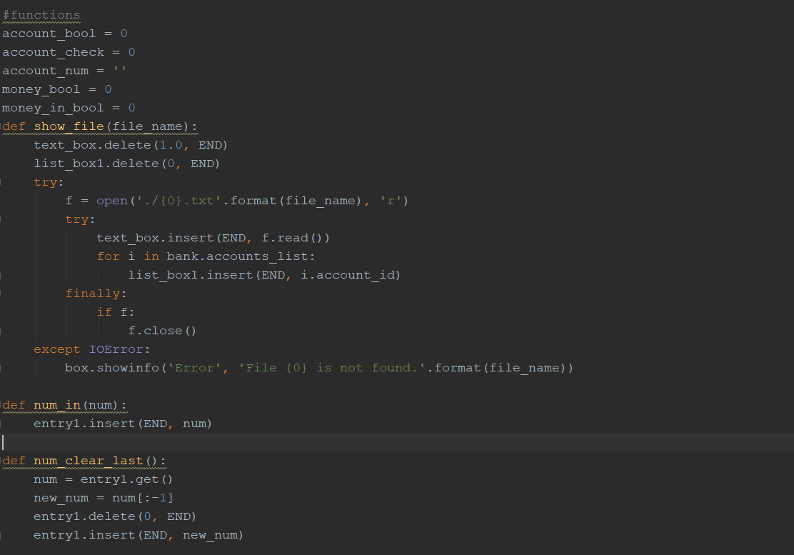
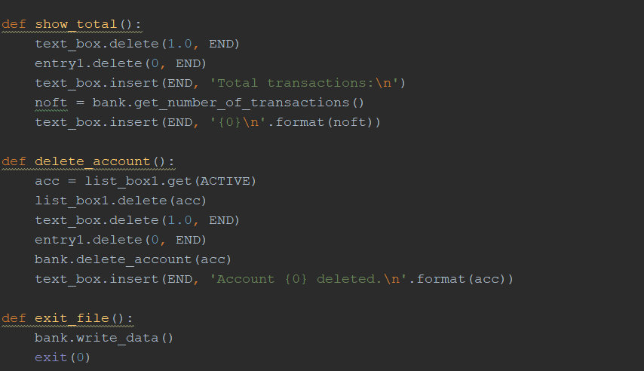
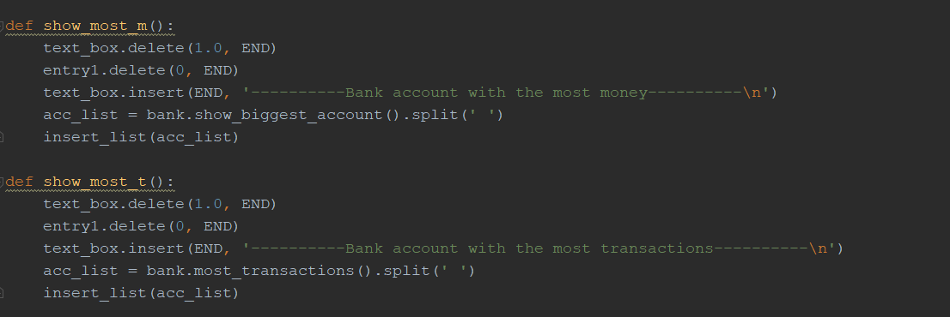
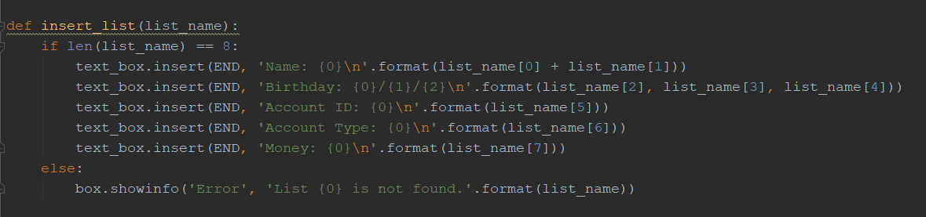
GUI function

Slide 11
Thanks for watching

